Slide 1

When your plans are turned upside down: being the leaf that does not wither

Slide 2
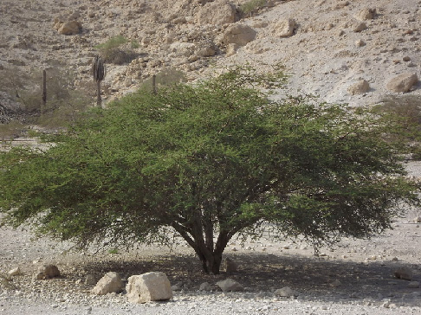
The Broom Tree
A bush with many branches and twigs, small leaves, and clusters of flowers.

Slide 3
WRITING A LAMENT - 4 components
1. Laments typically open with an ADDRESS. Psalm 22 begins with “My God, my God.”
2. Psalms of lament will contain a COMPLAINT: “Yet for your sake we faced death all day long; we are considered as sheep to be slaughtered” Psalm 44:22
3. Make a REQUEST to God for help. “Awake, Lord! Why do you sleep? Rouse yourself! Do not reject us forever” Psalm 44:23
4. A lament will incorporate an AFFIRMATION OF TRUST in God, often remembering his previous acts of faithfulness: “But I trust in your unfailing love; my heart rejoices. In your salvation. “ Psalm 13:5

Slide 4
“It is enough; now O LORD, take away my life, for I am no better than my fathers.”

Slide 5
Example: Ps. 13
How Long, O Lord?
To the choirmaster. A Psalm of David.
How long, O Lord? Will you forget me forever?
How long will you hide your face from me?
² How long must I take counsel in my soul
and have sorrow in my heart all the day?
How long shall my enemy be exalted over me?
³ Consider and answer me, O Lord my God;
light up my eyes, lest I sleep the sleep of death,
⁴ lest my enemy say, “I have prevailed over him,”
lest my foes rejoice because I am shaken.
⁵ But I have trusted in your steadfast love;
my heart shall rejoice in your salvation.
⁶ I will sing to the Lord,
because he has dealt bountifully with me.
Notes:
Take out some paper and a pen

Slide 6
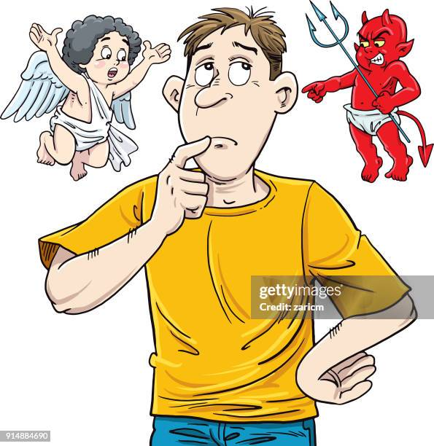
2 Messengers
One to end his life.
The other to sustain his life.

Slide 7
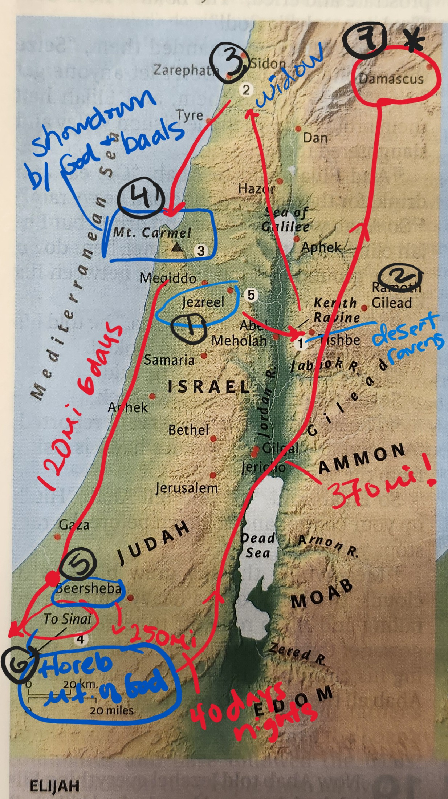
Elijah’s journey

Slide 8
Elijah says,
“I have been very jealous for the LORD, the God of hosts. For the people of Israel have forsaken your covenant, thrown down your altars, and killed your prophets with the sword, and I, even I only, am left, and they seek my life, to take it away.” (1 Ki. 19:9)

Slide 9
Make Room
Shake up the ground of all my tradition
Break down the walls of all my religion
Your way is better
Your way is better (3x)
I will make room for you, Jesus, to do whatever you want to
I’ll do whatever you want to (2x)
Here is where I lay it down
You are all I’m chasing now
This is my surrender

Slide 10
Being the leaf that does not wither
Attend to your physical body – eat, drink, sleep
Attend to your mental/emotional well-being, lament, be honest with the Lord
Attend to your spirituality – the Lord leads, FOLLOW Him:
  Bible study, read, meditate, pray
  Serve with your spiritual gifts, do the things He created you to do
  Fruit of the Spirit

Slide 12
A few Scriptures
Pr. 3:5-6
Ps. 46:10 “Be still, and know that I am God.
I will be exalted among the nations,
I will be exalted in the earth!”
Is. 46:10 ‘My counsel shall stand,
and I will accomplish all my purpose,’

Slide 13

Resources
Read the Bible in One Year plan
Spiritual Disciplines for the Christian Life by Donald Whitney
Women, Work, and Calling by Joanna Meyer
Beth Moore All My Knotted-Up Life A Memoir
What Made That Feel So Hard? By Lauren Wells
Atomic Habits by James Clear
Good Boundaries and Goodbyes by Lysa Terkeurst
Experiencing God Bible Study by Henry Blackaby
Foolproofing Your Life by Jan Silvious
Mary did a Bible study: Dealing with Foolish People
https://christianworkingwoman.org/event/winter-zoom-bible-study-3/

Slide 14
God bless you

